Slide 1

APPLIED SCIENCE AND ENGEENIRING PROJECT 2(ASEP) PROJECT_PPT FOR MID SEMESTER ASSIGNMENT –MAY 2025
ASEP2PROJECT_TITLE :- AI-Powered Digital Twin for Productivity Automation
Div:-AIDS-C ASEP2_GROUP No:-5 Day:-Tuesday Date:-20-05-25
Presented by:
NAME:- | (PRN no.)
ANANNYA KADAM | 12410456
OM KADAM | 12410442
PARTHA KADAM | 12412326
VEDANTI KADAM | 12412823
RAM KADU | 12410393
AJITESH KALE | 12414473
PROJECT GUIDE:
Prof. Amruta Bhawarthi
DEPARTMENT OF ENGINEERING SCIENCES AND HUMANITIES(DESH)
VISWAKARMA INSTITUTE OF TECHNOLOGY

Slide 2




CloneFlow is an tool which solves the problem of generating context aware email and replies and is also integrated with google meet and google calendar The application aims to END repetitive task of writing emails

Slide 3



Key Features of CloneFlow
Context Aware (RAG): Uses RAG to generate context aware responses
Chatbot: Chatbot can send emails, schedule meetings ,events with context aware response​
To-Do List & Workflow Automation:​
Helps you organize your daily task. the system automatically creates a list of things you need to do based on your priorities and its keep track of your progress. It gives smart suggestions to make your work easier and faster.​
​

Slide 4

Current Status of Project
r
Progress :
Compose email: Successfully developed and tested the Email Generation feature, which drafts personalized responses based on user communication history .
Document fetching functionality : document can be pdf, word, excel contact list allowing the AI system to retrieve contextually relevant information for improved response accuracy using retrieval-augmented generation (RAG).
Chatbot: we integrated a chatbot which will interact with user and directly will send email with a single Prompt.

Slide 5

Current Status of Project
Work remaining :
meet summarizer : Implementation of the Meeting Summary feature, which will extract and generate concise summaries from virtual meeting transcripts (e.g., Google Meet).
To-do list : Development of the To-Do list which will Automatically create tasks from conversations and user's email.
r

Slide 6






Tech Stack
Backend:
LangGraph
FastAPI
ChromaDB
Google Cloud
Frontend :
ReactJS Vite
Vanilla CSS

Slide 7
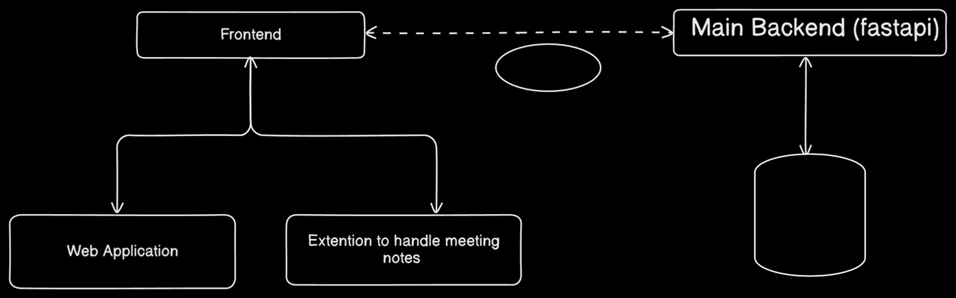
Basic Architecture
r
Frontend communicating with a Main Backend (fastapi) via Websocket. The Frontend interacts with a Web Application and an Extension to handle meeting notes. The Main Backend is connected to a Database.

Slide 8
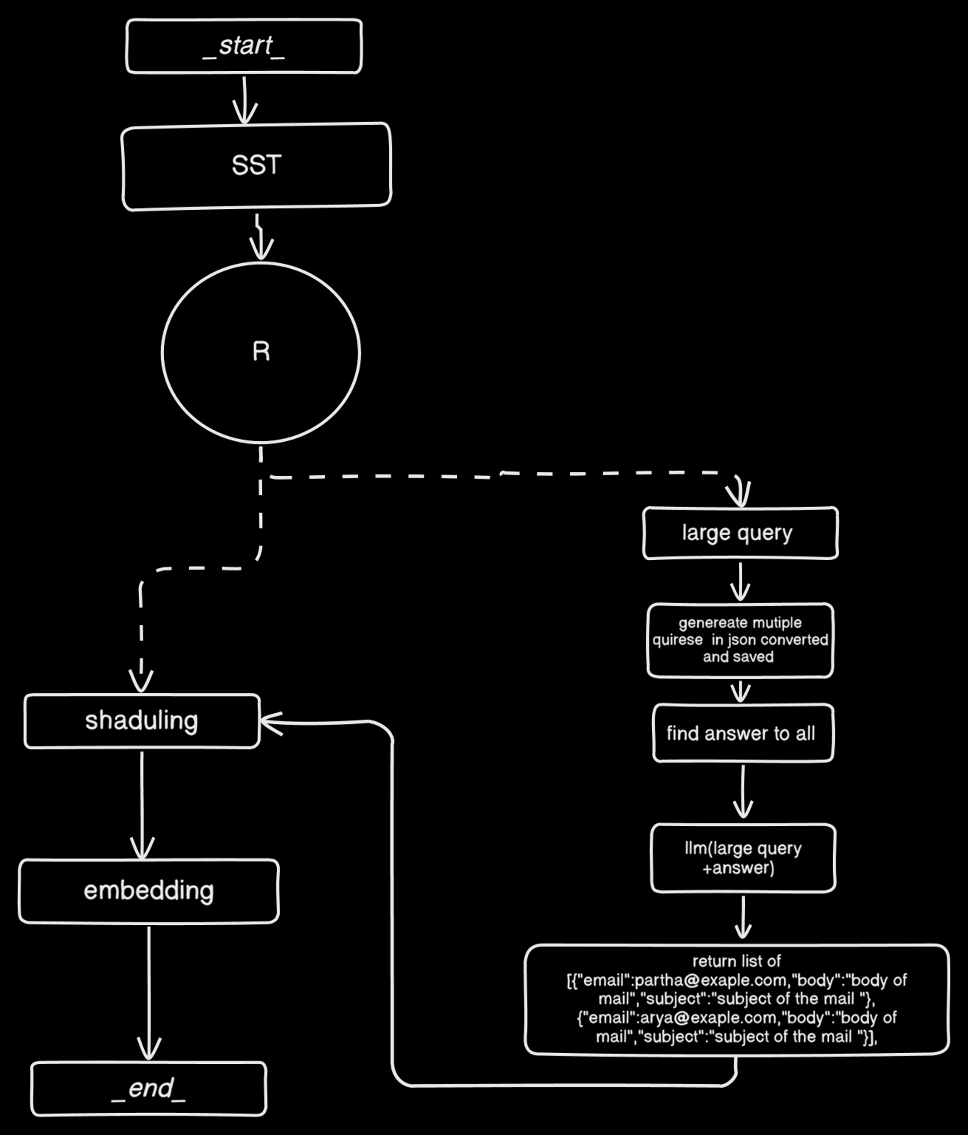
r
AI Work Flow For meetings

Slide 9
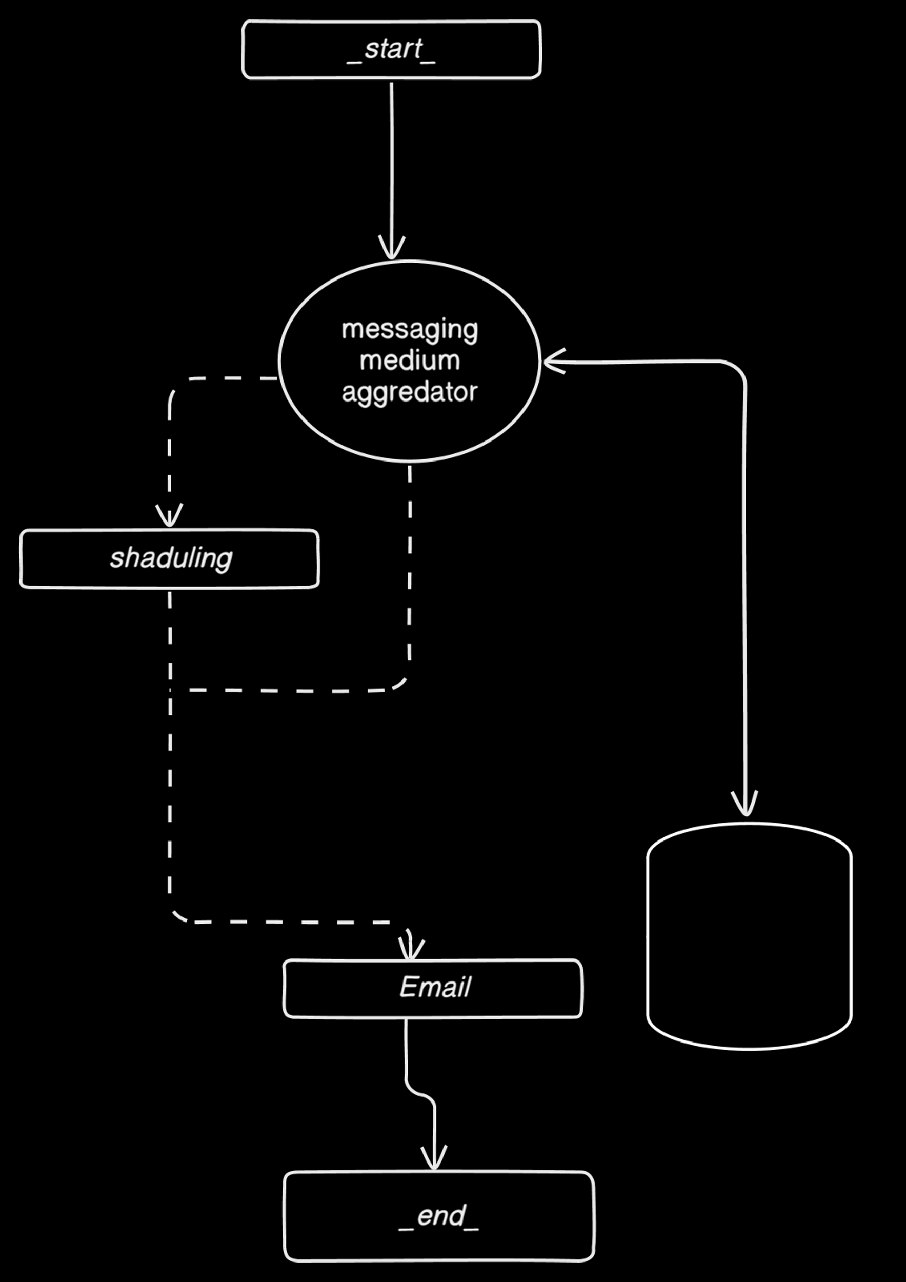
r
AI Work Flow For Chatbot

Slide 10
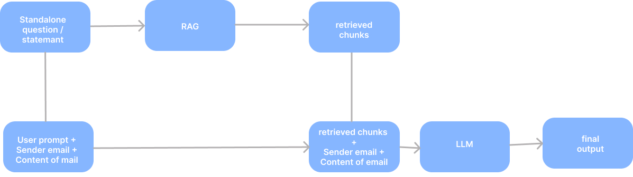
Methodology for generating context aware email

Slide 11
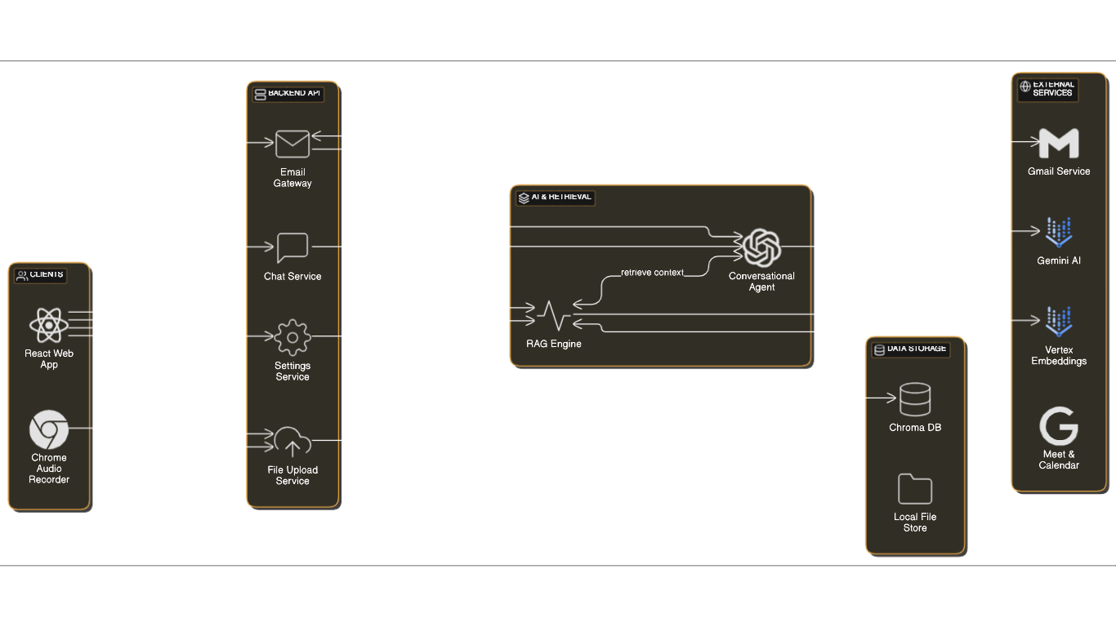

Slide 12


Github repository
CloneFlow github
https://github.com/parthakadam2007/CloneFlow

Slide 13
CONCLUSION
“AI-Powered Digital Twin for Productivity for Automation”.​
title of our project is “AI-Powered Digital Twin for Productivity Automation”.​
Develops an intelligent, web-based platform that creates a virtual digital twin of the user. ​
The digital twin learns from user behavior, communication style, and preferences. ​
Uses advanced AI techniques, including Retrieval-Augmented Generation (RAG), to personalize assistance. ​
Mimics the user’s tone and writing style to provide context-aware support. ​
Aims to assist users in managing daily digital tasks efficiently.​

Slide 14
References
[1] S. Shabani, A. R. Baqersad, and A. Zolghadri, “Digital twin designs with generative AI: Crafting a comprehensive framework for manufacturing systems,” Procedia CIRP, vol. 118, pp. 515–520, 2023. doi: https://doi.org/10.1016/j.procir.2023.03.141
[2] A. Madni and S. Madni, “Artificial Intelligence for Digital Twin,” in 2020 IEEE Aerospace Conference, Big Sky, MT, USA, 2020, pp. 1–8. doi: https://doi.org/10.1109/AERO47225.2020.9172356
[3] C. Chen, Q. Guo, C. Xiong, and P. Yu, “LEARN-BY-INTERACT: A Data-Centric Framework for Self-Adaptive Agents in Realistic Environments,” in Proceedings of the 37th AAAI Conference on Artificial Intelligence (AAAI-23), vol. 37, no. 9, 2023, pp. 10343–10351.
[4] J. Lee, B. Bagheri, and H.-A. Kao, “Intelligent Acting Digital Twin (IADT),” IFAC-PapersOnLine, vol. 48, no. 3, pp. 1088–1092, 2015. doi: https://doi.org/10.1016/j.ifacol.2015.06.235
[5] Z. Zhang, S. Dong, and W. Wang, “QuIM-RAG: Advancing Retrieval-Augmented Generation With Inverted Question Matching for Enhanced QA Performance,” arXiv preprint, arXiv:2307.11618, 2023. Available: https://arxiv.org/abs/2307.11618
[6] G. Tao, R. Xu, and H. Wang, “Artificial intelligence in digital twins: A review,” Advanced Engineering Informatics, vol. 49, p. 101641, 2021. doi: https://doi.org/10.1016/j.aei.2021.101641

Slide 15
THANK YOU

